Slide 1
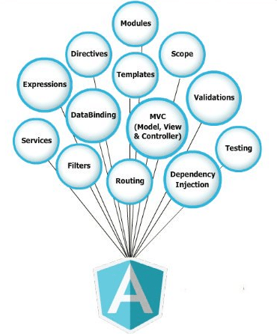
Angular 6

Slide 2
Angular CLI
Angular CLI is a command-line interface tool that helps generate, develop, and maintain Angular projects directly from a command shell

Slide 3
What is Angular
Angular is a development platform for building a Single Page Application for mobile and desktop.
AngularJS is a JavaScript framework that operates on the client-side
the code you write will be executed by the browser and not by the server.
It uses Typescript & HTML to build Apps.
The Angular itself is written using Typescript.
Angular is loaded with features like components, Directives, Forms, Pipes, HTTP Services, Dependency Injection, etc.

Slide 4
Why AngularJS?
When develop web pages using AngularJS, the pages will not be refreshed frequently due to the operations that a user performs on the webpage. This, in turn, is necessary to give faster output to the users via the webpage.

Slide 5
Angular Building blocks
Angular application consists of several building blocks.
There are seven main building blocks.
Components
Templates
Metadata
Data Binding
Directives
Services
Dependency Injection

Slide 6
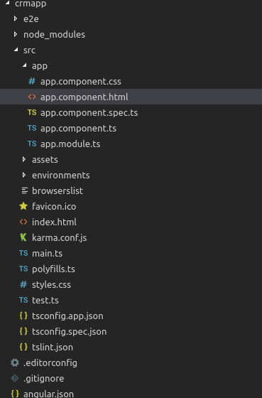
the directory structure of the project:

Slide 7
Components in Angular
A component is a TypeScript class.
It has an HTML template and an optional set of CSS styles that control a part of the screen.
One important aspect of components is re-usability.
A component can be re-used throughout the application and even in other applications.
Common and repeatable code that performs a certain task can be encapsulated into a reusable component.

Slide 8
component
It is an independent block of a big system (web application).
It communicates with the other building blocks (components) of the system using inputs and outputs.
A component has associated view, data, and behavior. It may have parent and child components.
A component is a TypeScript class with the @Component decorator applied to it.
A component’s View controls a part of the GUI (Graphical User Interface), and the component’s Logic controls how the component will function, both on its own and in relation to other components.
Templates
The template is the part of the component that defines the View.

Slide 9
Metadata
Metadata tells Angular how to process a class.
A class decorator uses a configuration object, with metadata, that provides Angular the information it needs about the class.
For example, the @Component decorator has metadata like selector, templateURL etc.

Slide 10
Angular application project folder and open the src/app folder.
app.component.css: the CSS file for the component
app.component.html: the HTML view for the component
app.component.spec.ts: the unit tests or spec file for the component
app.component.ts: the component code (data and behavior)
app.module.ts: the application main module

Slide 11
ex
import { Component } from '@angular/core’;
@Component({
selector: 'app-root',
templateUrl: './app.component.html',
styleUrls: ['./app.component.css’]})
export class AppComponent
{ title = 'app’;
}
The title variable is a member variable that holds the string ‘app’.
The export keyword is used to export the component so that it can be imported from other components and modules in the application.

Slide 12
component
selector: specifies the tag that can be used to call this component in HTML templates just like the standard HTML tags
templateUrl: indicates the path of the HTML template that will be used to display this component (you can also use the template parameter to include the template inline as a string)
styleUrls: specifies an array of URLs for CSS style-sheets for the component

Slide 13
What Is a Selector?
selector is an important attribute in Angular. It helps the application identify where to place components. The selector is always a string. Selectors can be defined in three different ways, each with a unique use case:
selector: 'calculator' can be used when the component is going to be specified as a <calculator> element in the HTML.
selector: '.calculator' can be used if the component is going to be used as a CSS element, which would look like <div class="calculator"> in the HTML.
selector: '[calculator]' can be used when the component ought to be used as an attribute, which would look like <div calculator>.

Slide 14
What Is a Template?
The templateUrl is used to identify the template a component will use.
The path to the template should be relative.
For a template in the same folder as the component source code, you could use templateUrl: './calculator.html' or templateUrl: 'calculator.html'.

Slide 15
What Is a styleUrl?
A component is never plain;
it is always loaded with multiple styles.
The role of the styleUrl attribute is to help you include component-specific CSS.
Just like for templates, you can use inline styling with the styles attribute. But if the code has a significant amount of styling, this needs to be separated into a different file.
Note that styleUrl always takes an array, so you can add multiple stylesheets.

Slide 16
Component Lifecycle
Here are the lifecycle hooks of an Angular component in the order each hook would be invoked.
component constructor
ngOnChanges
ngOnInit
ngDoCheck
ngAfterContentInit
ngAfterContentChecked
ngAfterViewInit
ngAfterViewChecked
ngOnDestroy

Slide 17
What is an Angular Module?

Slide 18
Angular Modules or ngModule
The building blocks of Angular Applications consist of Components, Templates, Directives, Pipes, and Services.
It help us to organize our code into manageable parts or blocks.
Each block implements a specific feature.
The Angular itself is built on the concept of Modules.
The @angular/core is the main Angular module, which implements Angular’s core functionality, low-level services, and utilities.

Slide 19
Angular Modules or ngModule
The Features like Forms, HTTP, and Routing are implemented as separate Feature modules such as FormsModule, HttpClientModule, and RouterModule.
There are many third-party libraries built around Angular such as Material Design, Ionic, etc.

Slide 20
Modules
Modules are a way to group related components and directives, along with the services, pipes, and other codes that they rely on, into a single cohesive unit.
Modules provide a way to keep the code organized and make it easier to reuse components and directives across different parts of the application.
Modules are defined using the Angular NgModule decorator, which takes an object that specifies the components, directives, and other code that the module contains.

Slide 21
The @NgModule decorator properties that describe the module are:
declarations: The classes that belong to this module and are related to views. There are three classes in Angular that can contain views: components, directives and pipes.
exports: The classes that should be accessible to other modules components.
imports: Modules whose classes are needed by the components of this module.
providers: Services present in one of the modules which are going to be used in the other modules or components. Once a service is included in the providers, it becomes accessible in all parts of that application.
bootstrap: The root component which is the main view of the application. Only the root module has this property and it indicates the component that's gonna be bootstrapped.
entryComponents: An entry component is any component that Angular loads imperatively, (which means you're not referencing it in the template), by type.

Slide 22
JavaScript Modules
The JavaScript Modules, which also go by the name JS modules or ES modules, or ECMAScript modules are part of the JavaScript Language.
The JS Modules are stored in a file.
There is exactly one module per file and one file per module. These modules contain small units of independent, reusable code.
They export a value, which can be imported and used in some other module.
The following is a Javascript Module that exports the SomeComponent.
export class SomeComponent {
//do something
}

Slide 23
ex
The SomeOtherComponent is another JavaScript Module, that imports and uses the SomeComponent.
import { SomeComponent } from './some.component';
export class SomeOtherComponent {
/do some other thing
}

Slide 24
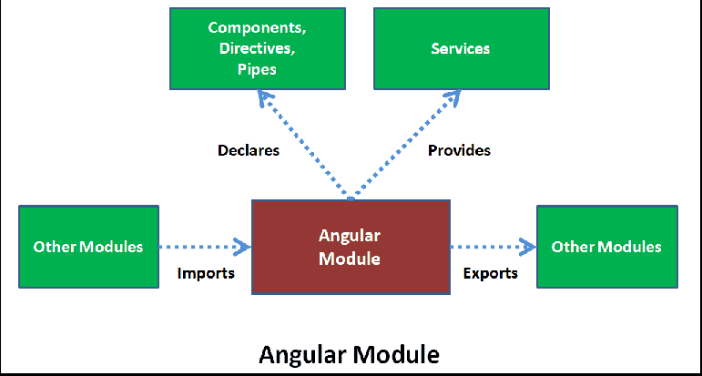
How to Create an Angular Module
The Angular Module must declare the Components, Pipes, and Directives it manages. We Create the Angular Modules by decorating it with the ngModule decorator.
@NgModule({
declarations: [ ],
imports: [ ],
providers: [ ],
exports: [ ],
bootstrap: [ ],
entrycomponents: [ ]
})

Slide 25
Creating a Module
Step 1 : Let us add three components.
HomeComponent,
AboutUsComponent,
ContactUsComponent.
Create a folder called pages under the home folder. Create a three folder under pages aboutus, contactus & home.

Slide 26
home/pages/aboutus/about-us.component.ts
import { Component } from '@angular/core';
@Component({
templateUrl: './about-us.component.html',
})
export class AboutUsComponent
{
}
home/pages/aboutus/about-us.component.html
<h1> About Us Page</h1>

Slide 27
home/pages/contactus/contact-us.component.ts
import { Component } from '@angular/core';
@Component({
templateUrl: './contact-us.component.html',
})
export class ContactUsComponent
{
}
home/pages/contactus/contact-us.component.html
<h1> Contact Us</h1>

Slide 28
home/pages/home/home.component.ts
import { Component } from '@angular/core';
@Component({
templateUrl: './home.component.html',
})
export class HomeComponent
{
}
home/pages/home/home.component.html
<h1> Welcome To Module Demo</h1>

Slide 29
home/pages/index.ts
export * from './aboutus/about-us.component';
export * from './contactus/contact-us.component';
export * from './home/home.component';

Slide 30
Home Module : home.module.ts
import { NgModule } from '@angular/core’; // @NgModule to let Angular know that it is an Angular Module
import { RouterModule, Routes } from '@angular/router';
import { CommonModule } from '@angular/common';
import { AboutUsComponent,ContactUsComponent,HomeComponent } from './pages';
const routes: Routes = [
{ path: '', component: HomeComponent },
{ path: 'home', component: HomeComponent },
{ path: 'contactus', component: ContactUsComponent },
{ path: 'aboutus', component: AboutUsComponent },
];
@NgModule({
declarations: [AboutUsComponent,ContactUsComponent,HomeComponent], //declarations array to declare the three components that we have created.
imports: [ CommonModule, RouterModule.forChild(routes),
], providers: [], // do not expose any services, hence we keep the providers array empty
}) export class HomeModule { }

Slide 31
home/index.ts
export * from './pages';
export * from './home.module';

Slide 32
Using HomeModule in AppModule
import { HomeModule} from './home’;
imports metadata of the @ngModule
imports: [
BrowserModule,
AppRoutingModule,
HomeModule
],

Slide 33
app.component.ts
<ul>
<li>
<a class="navbar-brand" routerLink="/">Home</a>
</li>
<li>
<a class="navbar-brand" routerLink="/aboutus">About</a>
</li>
<li>
<a class="navbar-brand" routerLink="/contactus">Contact</a>
</li>
</ul>
<router-outlet></router-outlet>

Slide 34
app.component.css
ul {
list-style-type: none;
margin: 0;
padding: 0;
overflow: hidden;
background-color: #333333;
}
li {
float: left;
}
li a {
display: block;
color: white;
text-align: center;
padding: 16px;
text-decoration: none;
}
li a:hover {
background-color: #111111;
}

Slide 35
Angular Imports
to find external functionality that we use in our module.
All external dependencies like third party libraries, built-in or custom modules must be imported before we have access to their functionality.
It’s similar to the import statement from Java

Slide 36
Angular Classes and decorators
Most of the logic in Angular is built with regular TypeScript classes. We also add decorators that tell Angular how to treat a class.
For example, the @Component decorator tells Angular that the class is a component. Currently, Angular has the following decorators.
@NgModule
@Component
@Injectable
@Directive
@Pipe
@Input
@Output
@HostBinding
@HostListener
@ContentChild
@ContentChildren

Slide 37
Why use AngularJS?
Easy to work with: All you need to know to work with AngularJS is the basics of HTML, CSS, and Javascript, not necessary to be an expert in these technologies.
Time-saving: AngularJs allows us to work with components and hence we can use them again which saves time and unnecessary code.
Ready to use a template: AngularJs is mainly plain HTML, and it mainly makes use of the plain HTML template and passes it to the DOM and then the AngularJS compiler. It traverses the templates and then they are ready to use.

Slide 38
Key Features: Model View Controller(MVC):
An architecture is basically a software pattern used to develop an application. It consists of three components:
Model: This component consists of a database & is responsible for managing the data & logic of the application. It responds to the request made by the View component & the instruction given by the Controller component, in order to update itself.
View: This component is responsible for displaying the application data to the users. The View is basically the user interface that helps to render the required data to the user, with the help of the AngularJS expressions.
Controller: This component is responsible for communicating & interacting between the Model & the View Component, i.e. its main job is to connect the model and the view component. It helps to validate the input data by implementing some business logic that manipulates the state of the data model.

Slide 39
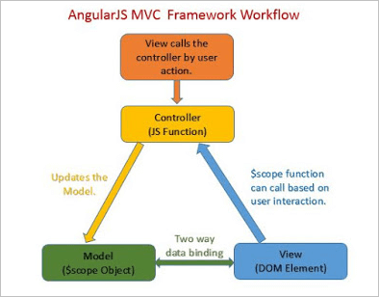

Slide 40
Dependency Injection
In software engineering, dependency injection refers to the passing of objects between the application and the client.
The injection is the phenomenon of passing a dependency (say an application service) to a dependent object (say a client) that would use it.
AngularJS provides several core components for achieving this purpose in simplicity.

Slide 41
How to implement Angular Dependency Injection?
Dependency injection is done by injecting a service class into a component or module class. Within the class, injected dependency can be used anywhere.

Slide 42
Directives
It helps us to manipulate the DOM.
Directives are classes that help us manipulate the View.
It can change a DOM element’s appearance, behavior, or layout using the directives.
It help to extend HTML.
The Angular directives are classified into three categories based on how they behave.
They are
Component,
Structural, and
Attribute Directives

Slide 43
Directives
to add the ng-app directive, else the expression will be displayed as it is, without being solved.
AngularJS expressions could be written inside double curly braces or can be written inside a directive.
Inside curly braces:
<div ng-app=””>
<p>My first expression in Angular JS: {{3+3}}</p>
</div>
Inside directive:
<div ng-controller=”Name of your controller”>
<element ng-bind="your expression"></element>
</div>
AngularJS Numbers
<div ng-app=””>
<p>The value of 5 times 10 is : {{5*10}}<p>
</div>
Expressions In AngularJS

Slide 44
<div ng-app=””>
<p>The value of 5 times 10 is : {{5*10}}<p>
</div>
Inside curly braces:
<div ng-app=”” ng-init=”first string variable name=’your first string’;second string variable name
=’your second string’”>
<p>My first string expression in Angular JS:
{{ first string variable name + second string variable name }}</p>
</div>
Inside directive:
<div ng-app=”” ng-init=” first string variable name=’your first string’;
second string variable name=’your second string’”>
<p>My first string expression in Angular JS:<span ng-bind=
" first string variable name + second string variable name "></span></p>
</div>
AngularJS Strings

Slide 45
Inside curly braces
<div ng-app=”” ng-init=”your object name=
{first variable name=’your first value’,second variable name
=’your second value’}”>
<p>My first object in Angular JS: {{ your object name.second variable name }}</p>
</div>
Inside directive
<div ng-app=”” ng-init=”your object name={first variable name=’your first value’,second variable name
=’your second value’}”>
<p>My first object in Angular JS:<span ng-bind=" your object name.second variable name "></span></p>
</div>
object could be accessed using the dot operator.
AngularJS Objects

Slide 46
Syntax:
Inside curly braces:
<div ng-app=”” ng-init=”your array name=[your first value,your second value]”>
<p>My first array in Angular JS: {{ your array name[1] }}</p>
</div>
Inside directive:
<div ng-app=”” ng-init=”your array name=[your first value,your second value]”>
<p>My first array in Angular JS: <span ng-bind="your array name[1] "></span></p>
</div>
AngularJS Arrays

Slide 47
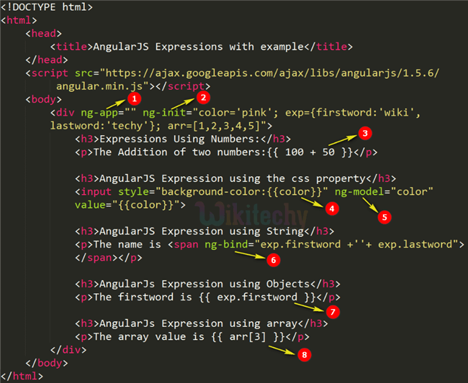

Slide 48
1. Component Directives:
Component directives are used in main class. They contain the detail of how the component should be processed, instantiated and used at runtime.

Slide 49
2. Structural Directives:
Structural directives start with a * sign. These directives are used to manipulate and change the structure of the DOM elements.
For example, *ngIf and *ngFor.

Slide 50
3. Attribute Directives:
Attribute directives are used to change the look and behavior of the DOM elements.
For example: ngClass, ngStyle etc.
Attribute directives look like a normal HTML Attribute and mainly used in databinding and event binding.

Slide 51
import {Directive, ElementRef, OnInit} from '@angular/core';
@Directive( {
selector: '[appSimpleStyle]'
})
export class SimpleStyleDirective implements OnInit {
constructor(private elementRef: ElementRef) {
}
ngOnInit() {
this.elementRef.nativeElement.style.backgroundColor = 'green';
}

Slide 52
Angular Databinding - as in {{}}.
It is used for communication.
To communicate between your TypeScript code (your business logic) and the other component which is shown to the users i.e. HTML layout.
Databinding is necessary because when we write the code in TypeScript, it is compiled to JavaScript and the result is shown on HTML layout. Thus, to show the correct and spontaneous result to the users, a proper communication is necessary. That's why databinding is used in Angular.

Slide 53
Angular Databinding
Angular uses Data Binding to communicate between a component’s View and its Logic.
This is done with special Angular-specific markup, known as Template Syntax.
Angular supports five types of Data binding:
Interpolation binds data from the Logic to the View.
Property Binding allows us to control the property of a HTML element.
Event Binding is how we react to events from the HTML template.
Two-way Binding allows us to combine Property and Event Binding to react to events and output data at the same time.
Custom Binding allows us to communicate between parent and child components by using special decorators.

Slide 54
There is two type of databinding:
1. One-way databinding
It is a simple one way communication where HTML template is changed when we make changes in TypeScript code.
Or
In one-way databinding, the value of the Model is used in the View (HTML page) but you can't update Model from the View. Angular Interpolation / String Interpolation, Property Binding, and Event Binding are the example of one-way databinding.

Slide 55

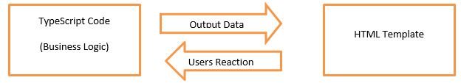
2. Two-way databinding
In two-way databinding, automatic synchronization of data happens between the Model and the View. Here, change is reflected in both components. Whenever you make changes in the Model, it will be reflected in the View and when you make changes in View, it will be reflected in Model.
This happens immediately and automatically, ensures that the HTML template and the TypeScript code are updated at all times.

Slide 56
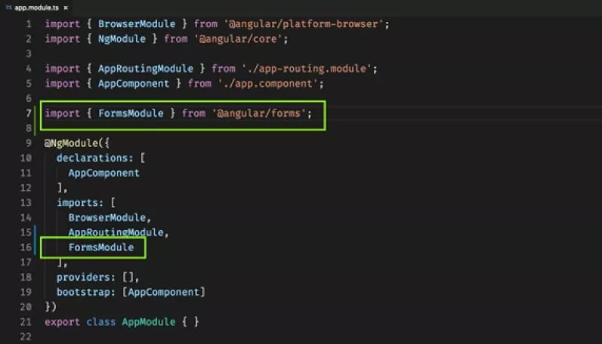
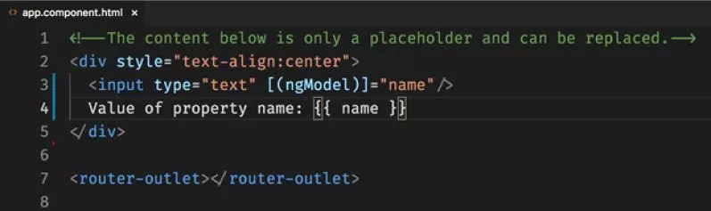
src/app/app.module.ts

Slide 57
String Interpolation
is used to display dynamic data on HTML template (at user end).
It facilitates to make changes on component.ts file and fetch data from there to HTML template (component.html file).
component.ts file:
import {Component} from '@angular/core';
@Component(
{selector: 'app-server',
templateUrl: 'server.component.html'})
export class ServerComponent {
serverID: number = 10;
serverStatus: string = 'Online';
}
component.html file:
<p>Server with ID {{serverID}} is {{serverStatus}}. </p>

Slide 58
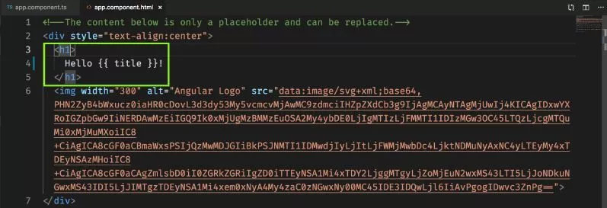
Interpolation

Slide 59
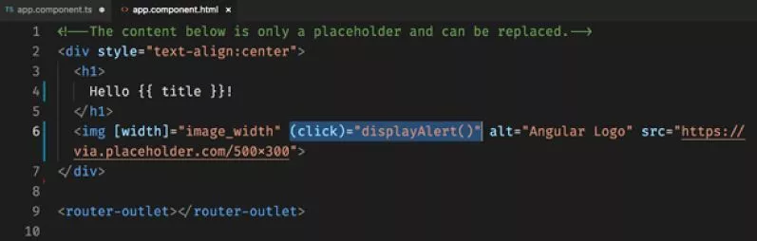
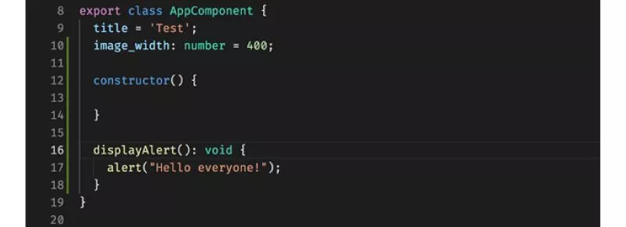
Event Binding
to bind the events along with the methods. This process is known as event binding. Event binding is used with parenthesis ().
component.html file:
<p>
Server2 is also working fine.
</p>
<button class="btn btn-primary"
[disabled]="!allowNewServer"
(click)="onCreateServer()">Add Server</button>
<!--<h3 [innerText]= "allowNewServer"></h3>-->
{{serverCreationStatus}}

Slide 60
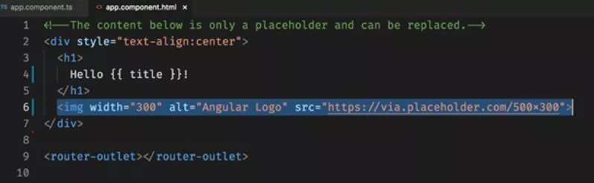


Property Binding
Property binding is the way to binding properties of various HTML elements and components to variables in the class. This allows us to update the UI as soon as the underlying data changes.

Slide 61
Pipes
used to Transform the Data.
It is denoted by symbol |
Syntax:
{{title | uppercase}}

Slide 62
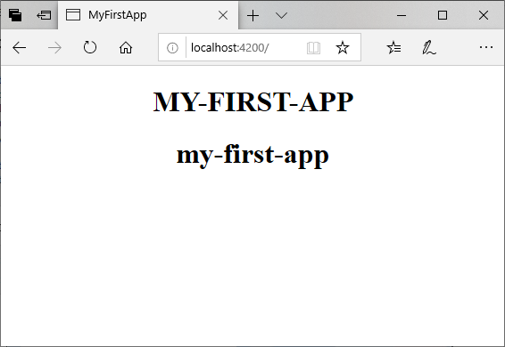
Pipes
Use the pipe symbol in component.html file:
Define a variable named "title" in component.ts file.
import { Component } from '@angular/core';
@Component({
selector: 'app-root',
templateUrl: './app.component.html',
styleUrls: ['./app.component.css']
})
export class AppComponent {
title = 'my-first-app';
}
<h1>
{{ title | uppercase }} <br/></h1>
<h1>
{{ title | lowercase }} <br/></h1>

Slide 63
Built-in Pipes
Lowercasepipe
Uppercasepipe
Datepipe
Currencypipe
Jsonpipe
Percentpipe
Decimalpipe
Slicepipe

Slide 64
Angular app navigation and routing
Angular has a specific module dedicated to navigation and routing, the RouterModule.
With this module you can create routes, which allows you to move from one part of the application to another part or from one view to another.

Slide 65
Angular app navigation and routing
It is used to create Single Page Applications (SPA’s).
These applications are entered only once, and new content is added when required dynamically.
Angular Routing facilitates navigation between multiple views. The process of defining the navigation element and the related view in the Angular is called Angular Routing.

Slide 66
Angular app navigation and routing
For routes to work, you need an anchor or element in the UI to map actions (typically clicks on elements) to routes (URL paths).
We use the routerLink directive for this purpose.
For example, when the user clicks on a Category name in the UI, Angular, through the routerLink directive, knows that it needs to navigate to the following url:
http://localhost:4200/questions/about/category-name

Slide 67
ex
<a class="list-title“
[routerLink]="['/questions/about', category.slug]">
{{category.title}
}</a>

Slide 68
import { Routes } from '@angular/router';
export const routes: Routes = [
{ path: '', component: CategoriesComponent, resolve: { data: CategoriesResolver}
},
{ path: 'questions/about/:categorySlug', component: CategoryQuestionsComponent,
resolve: { data: CategoryQuestionsResolver }
},
{ path: 'question/:questionSlug',
component: QuestionAnswersComponent,
resolve: { data: QuestionAnswersResolver }
}
];
import { routes } from './app.routes';
imports: [
RouterModule.forRoot(routes,
{ useHash: false }
)
],

Slide 69
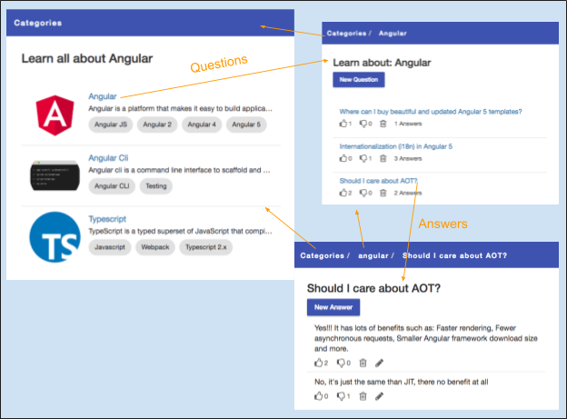
Angular app navigation and routing

Slide 70
Services
An Angular Service provides a common service or functionality to Components or other Services.
As an example, let’s consider a class that is responsible for logging messages to various parts of the application, like a failed login etc.
We don’t define logging functionality for each component, we define it as application-wide functionality, a service that can be used by any component.

Slide 71
Dependency Injection
dependency Injection is the method by which we provide a component with all the resources it needs. This can be modules, services etc.
Angular does this via the Injector. It looks at the metadata, then creates an instance of the Service and injects it into the Component via its constructor.
If the service already exists, the injector won’t create it but use the existing one.
The service will have to tell Angular that it can be injected into any components that require it, by using the @Injectable decorator.

Slide 72
Templates
In AngularJS, templates are written with HTML that contains AngularJS-specific elements and attributes. AngularJS combines the template with information from the model and controller to render the dynamic view that a user sees in the browser.
These are the types of AngularJS elements and attributes you can use:
Directive — An attribute or element that augments an existing DOM element or represents a reusable DOM component.
Markup — The double curly brace notation {{ }} to bind expressions to elements is built-in AngularJS markup.
Filter — Formats data for display.
Form controls — Validates user input.

Slide 73
<html ng-app>
<!-- Body tag augmented with ngController directive -->
<body ng-controller="MyController">
<input ng-model="foo" value="bar">
<!-- Button tag with ngClick directive, and
string expression 'buttonText'
wrapped in "{{ }}" markup -->
<button ng-click="changeFoo()">{{buttonText}}</button>
<script src="angular.js"></script>
</body>
</html>

Slide 74
Limitations of AngularJS
It is not a very secure JavaScript framework. Server-side authorization and authentication are necessary and significant to keep the codebase secure.
An application built using AngularJS is not degradable. This means that, when a user disables JavaScript, then he would just see the basic page and nothing apart from that.

Slide 75
Why Use AngularJS? / various features
Data Binding: The platform provides automatic sync of data between the model and view contents and as a result, it saves your time as well as the effort to a great extent.
Controller: These are JavaScript that is bound to a particular scope.
Services: AngularJS has many built-in services. E.g $https
Filters: This helps in selecting a subset of items from an array and returns it to a new array.
Directives: They are markers on DOM elements like attributes, CSS elements, etc. These can be used as custom tags of HTML.
Routing: Helps in creating single page applications. It is specified in the URL after the # sign and enables you to create different URLs for different content in your application.
MVC: Stands for Model, View, and Controller. It is a design pattern and is used for the division of an app into different parts, i.e., Model, View, and Controller.
Deep Linking: This feature of the app framework helps you to encode the state of the application in the URL for bookmarking. Later, the app can also be restored from the URL in the same state.
Dependency Injection: AngularJS also has an in-built dependency injection sub-system which can be helpful for the developer to make the process of development and testing easier, cohesive and straightforward.
Scope: These are the objects that act as a glue between the controller and the view.

Slide 76
Difference
a library - a collection of functions which are useful when writing web apps. Your code is in charge and it calls into the library when it sees fit. E.g., jQuery.
frameworks - a particular implementation of a web application, where your code fills in the details. The framework is in charge and it calls into your code when it needs something app specific. E.g., durandal, ember, etc.

Slide 77
Component | Module
A component is a class with an associated template that defines a view. | A module is a container for a group of related components and directives.
A component is responsible for rendering a view and handling user interactions with the view. | A module can contain services, pipes, and other code that is used by the components that are a part of the module.
A component is defined using a class and a template. | A module is defined using the Angular NgModule decorator.
A component controls a part of the screen called a view. | A module provides a way to group related functionality and keep the code organized.
A component can interact with other components or services. | A module can contain multiple components and directives.

Slide 78
Employee APP
https://www.javaguides.net/2019/02/angular-6-crud-app-example.html

Slide 79
https://www.tektutorialshub.com/angular/angular-modules/
https://docs.angularjs.org/guide/forms

